Slide 1

NATURAL LANGUAGE PROCESSING
Gathering Business insights using NLP

Slide 2
SPAM MAIL CLASSIFICATION
Objective 1
Objective 2
Objective 3
To classify the e-mails into spam and ham.
To find out the topics used mostly in spam mails.
Gather meaningful business insights.

Slide 3
Challenges and overcoming them
Challenge 1
Challenge 2
Datasets having subjects and e-mails in one column.
Topic modelling with subject line were giving limited topics for one type of mail.
Challenge 1
Challenge 2
Based on new line character, we separated subject line and body.
We modelled our e-mail body to get more topics for one e-mail.

Slide 4
OBSERVATIONS

Slide 5
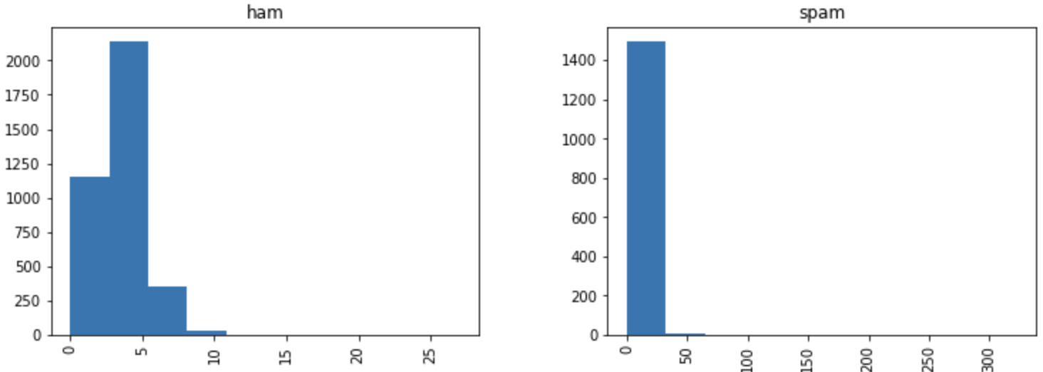
VERBOSE Subject line and e-mail body

Slide 6
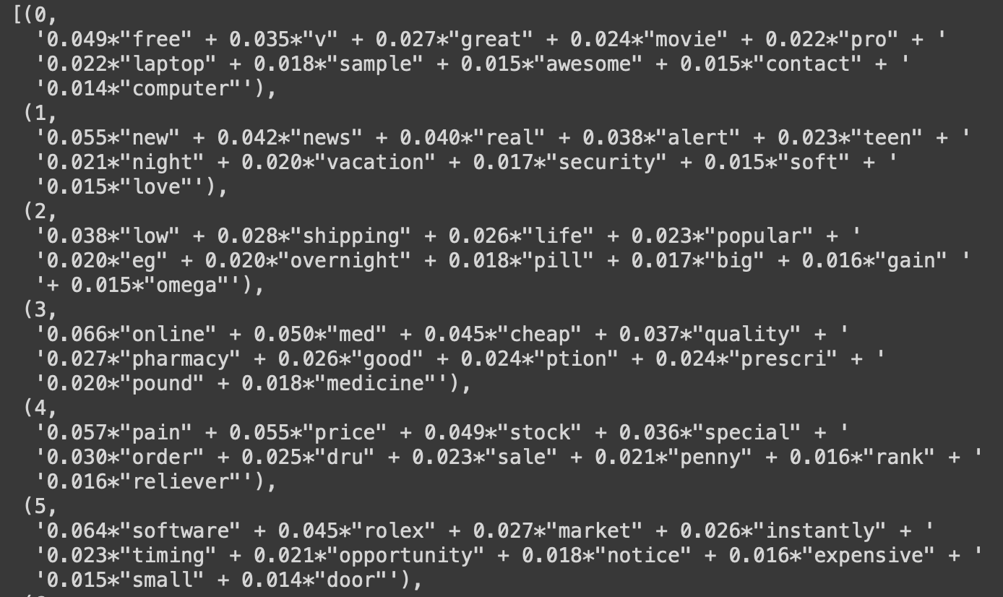
Topics from subject line

Slide 7
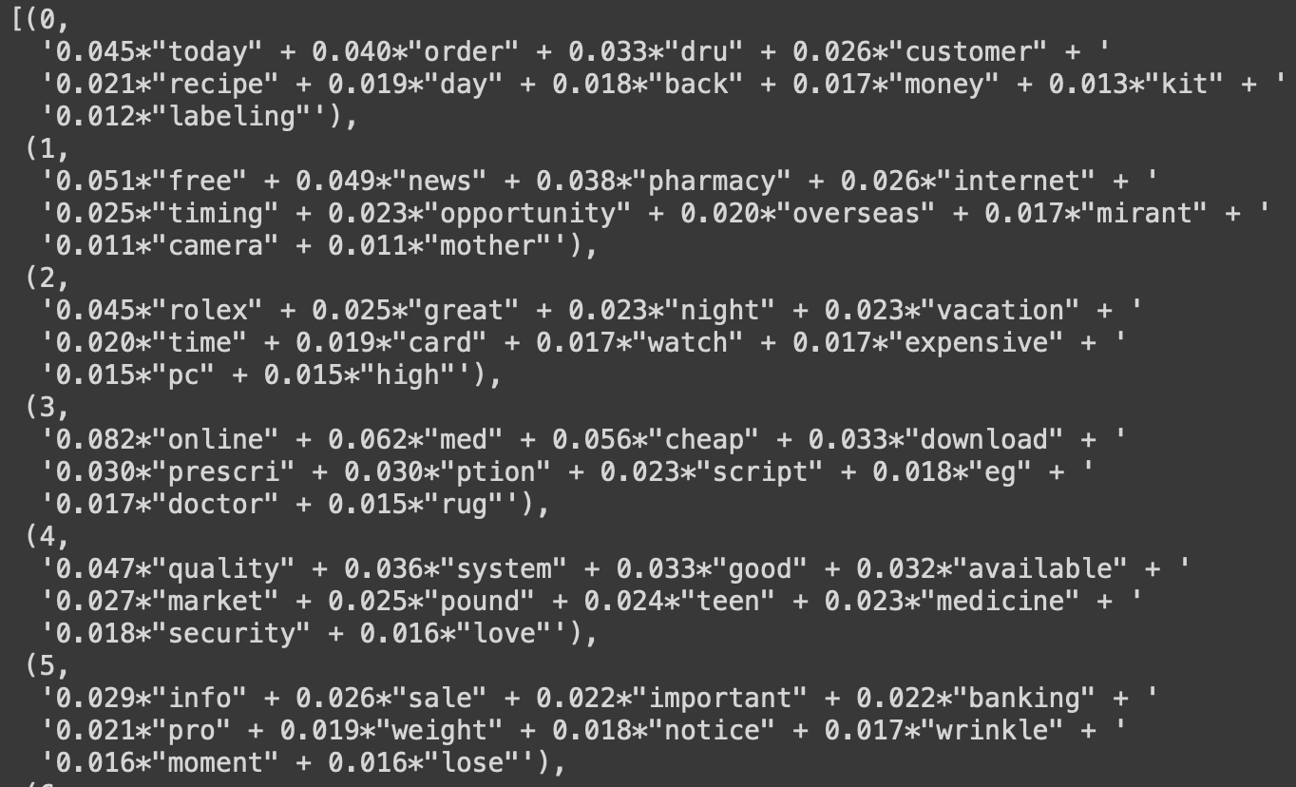
Topics from e-mail body

Slide 8
Business
Insights
Situation: We are sending marketing mail, and don’t want it to end up in spam mail
max growth
The subject line should not be verbose
The body should be concise
Words such as “free”, “cheap”, expensive brand names should be avoided

Slide 9
THANK YOU

